Slide 1
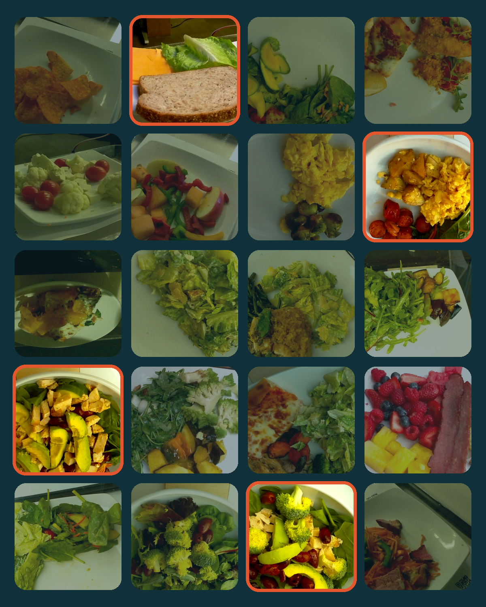
RASS
NeurIPS 2026 · Evaluations & Datasets Track
Risk-Audited Budget Selection for Compact NeRF Benchmark Subsets
48 scenes instead of 3,521, backed by a statistical audit
Ahmad AlMughrabi · Flavià Serret · Ricardo Marques · Petia Radeva
Universitat de Barcelona · Universitat Pompeu Fabra ·
Institut de Neurosciències, Barcelona
Notes:
What if you could benchmark on 48 food scenes instead of 3,521, with a statistical audit behind that choice? Hello, I'm Ahmad AlMughrabi from the University of Barcelona, presenting RASS, joint work with Flavià Serret, Ricardo Marques and Petia Radeva.

Slide 2

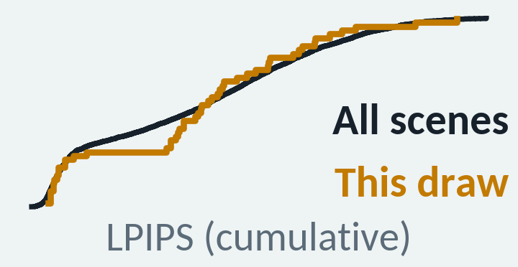

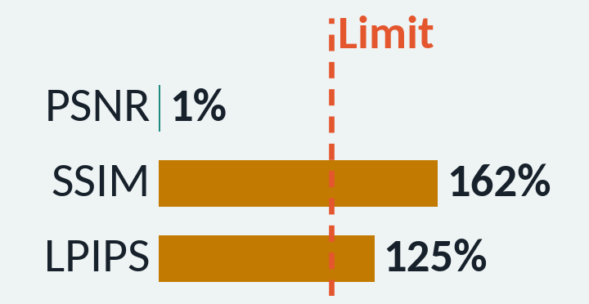


Full NeRF benchmarks are too costly to rerun for every idea
3,521
Ad hoc subsets can look right for the wrong reasons
Tail shift
NeRF trainings for every ablation on the full benchmark
A real 48-scene draw: every mean matches, but its LPIPS distribution (amber) drifts from the full set
512
Metric leakage
Another real draw: PSNR uses 1% of its tolerance, while SSIM and LPIPS exceed theirs
H100 GPUs, at most, to produce the full logs once
Sampling luck
One subset passes by chance; the next draw does not
Our question: what is the smallest subset that preserves the full-benchmark summaries, under explicit fidelity constraints?
Notes:
NeRF methods train one model per scene. So one ablation on our benchmark means 3,521 trainings, and producing those logs once took a supercomputer with up to 512 H100 GPUs. Small ad hoc subsets can look right for the wrong reasons. Top, a real draw: all three image-quality means match, but the amber LPIPS curve drifts. That's tail shift. Middle: PSNR matches, but SSIM and LPIPS overshoot. That's metric leakage. Bottom: one pass may just be luck. So, what is the smallest subset that keeps the full-benchmark summaries?

Slide 3
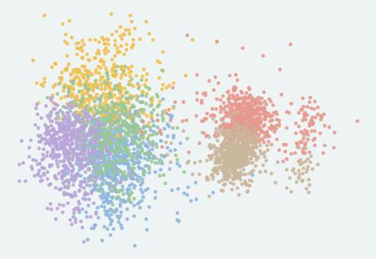
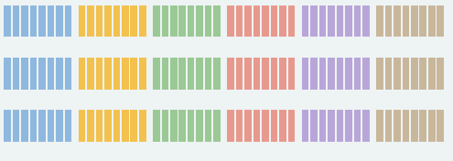



RASS audits a subset-generation procedure, not one lucky subset
1
2
3
4
Describe
Generate
Test
Audit
57-D descriptor per scene
K-Means → 6 regimes
Draw M = 400 candidates per budget B
Balanced: equal scenes per regime
All six must hold:
|ΔPSNR| ≤ 0.5 dB
|ΔSSIM| ≤ 0.01
|ΔLPIPS| ≤ 0.01
KS ≤ 0.14, per metric
Wilson 95% lower bound (LCB) on the pass rate
Pick the smallest B with LCB ≥ p_{min}
GUARDS AGAINST
GUARDS AGAINST
Tail shift
Sampling luck
× 400 draws
Metric leakage
Export: release one passing draw, picked by a fixed rule, and validate it on its own
Log-based: no GPU training; the audit reruns
on a CPU in minutes
Notes:
RASS answers with an audit. We describe each scene with 57 descriptors and cluster the scenes into six regimes. For each budget, meaning subset size, a balanced generator draws 400 candidates, with equal scenes per regime. Each candidate must pass six checks at once. The mean tolerances guard against leakage; a Kolmogorov-Smirnov, or KS, bound on each distribution guards against tail shift. Against luck, we audit the procedure: a 95% Wilson lower bound on its pass rate must clear a target, p-min. Budgets that clear it are certified, and we recommend the smallest. We then release one passing draw, chosen by a fixed rule, and validate it separately.

Slide 4
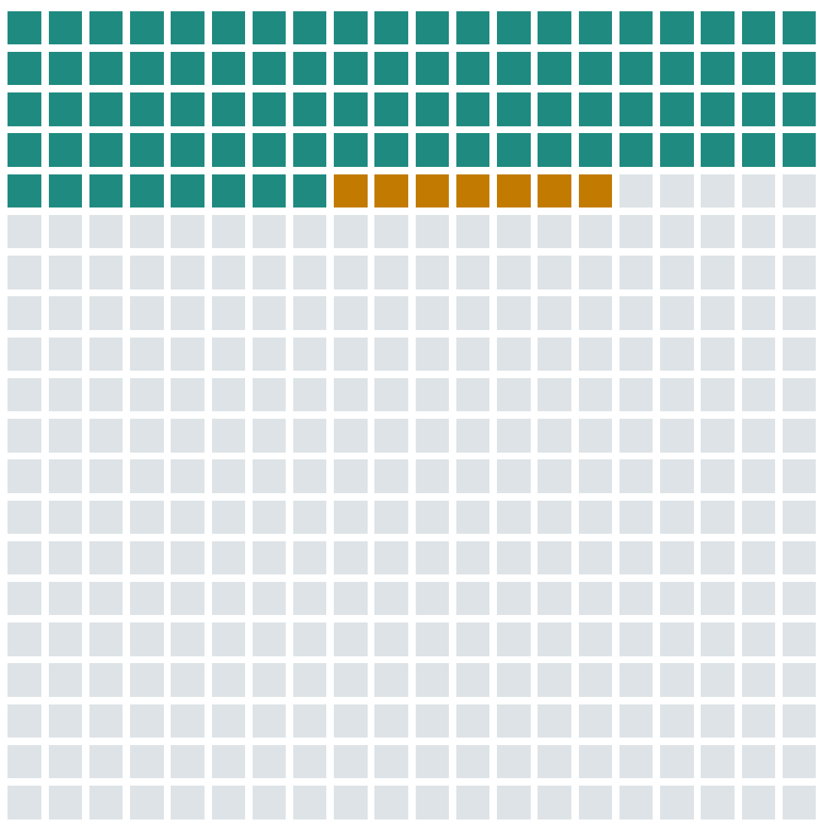

At 48 scenes, even the pessimistic pass rate clears the target
Pass all six constraints (88)
Means match, KS fails: tail shift caught (7)
Fail a mean constraint (305)
Pass rate 88 / 400 = 0.22
Wilson 95% LCB 0.182 ≥ p_{min} = 0.08
48 scenes certified
p_{min} is a yield: on average, at most 12.5 cheap log checks find a passing subset.
The 400 real candidate draws at 48 scenes
Notes:
Take one budget, 48 scenes: here are its 400 real draws. Teal: 88 pass all six. Amber: seven match every mean but fail KS, so the tail shift is caught. Grey: the rest miss a mean. Pass rate: 0.22. Even the pessimistic lower bound, 0.182, clears p-min of 0.08, so the 48-scene budget is certified. Read p-min as a yield: on average, at most twelve and a half cheap log checks find a passing subset.

Slide 5
The frontier trades scenes for reliability
Pass rate
Target p_{min} = 0.08
Wilson LCB
RASS-48
48 scenes · LCB 0.182
Screening & ablations
Smallest evaluated budget
Target p_{min} = 0.08
48
60
72
96
120
Subset size (scenes, balanced generator)
Notes:
Repeating this for every budget on our grid gives the cost-reliability frontier. Teal is the pass rate; red is its lower bound. With the target at 0.08, the bound clears it at 48 scenes, our smallest evaluated budget: RASS-48, for screening and ablations.

Slide 6
The frontier trades scenes for reliability
Pass rate
Target p_{min} = 0.08
Wilson LCB
RASS-48
First LCB ≥ 0.20
48 scenes · LCB 0.182
Target p_{min} = 0.20
Screening & ablations
Target p_{min} = 0.20
Target p_{min} = 0.08
RASS-96
96 scenes · LCB 0.241
48
60
72
96
120
Compact reporting
Subset size (scenes, balanced generator)
Notes:
Raise the target to 0.20, and the bound first clears it at 96 scenes: RASS-96. It costs twice the scenes but carries a stronger guarantee, so we recommend it for results you report. Pick the reliability you need.

Slide 7

RASS-48 passes the global audit with 73× fewer scenes
Share of each tolerance that RASS-48 uses
73×
Limit
fewer scenes: 3,521 → 48
8 scenes from each of the 6 descriptor regimes
Joint pass, all six
Notes:
Back to RASS-48: now we check the released subset itself. Each bar shows how much of its tolerance the subset uses. All six stay under the limit; the closest, LPIPS KS, uses 80 percent. That's 73 times fewer scenes than the full benchmark, eight from each regime. The guarantee is global: the whole benchmark, not each regime.

Slide 8



One audit covers more methods, generators, and datasets
RASS-96 passes the
3- and 4-method audits
Any candidate
generator plugs in
The protocol
transfers to DL3DV
Constraints passed in joint audits
Smallest certified size (scenes)
64 / 140
 | 3 methods | + nerfacto
RASS-48 | 14/16 | 19/22
RASS-96 | 16/16 | 22/22
DL3DV scenes certified for four methods (32 for one)
✓
✓
Contract re-declared for DL3DV; proportional allocation, added post hoc.
✗ k-center fails up to 96
So RASS-96 is our subset
for reported results.
Balanced also passes at 36 on an extended grid.
Notes:
So far, everything used one method's logs, Zip-NeRF. In a joint audit, every method must pass on the same subset. For three methods, RASS-48 passes 14 of 16 checks. RASS-96 passes all 16, and all 22 with nerfacto added.

Slide 9
One audit covers more methods, generators, and datasets
RASS-96 passes the
3- and 4-method audits
Any candidate
generator plugs in
The protocol
transfers to DL3DV
Constraints passed in joint audits
Smallest certified size (scenes)
64 / 140
 | 3 methods | + nerfacto
RASS-48 | 14/16 | 19/22
RASS-96 | 16/16 | 22/22
DL3DV scenes certified for four methods (32 for one)
✓
✓
Contract re-declared for DL3DV; proportional allocation, added post hoc.
✗ k-center fails up to 96
So RASS-96 is our subset
for reported results.
Balanced also passes at 36 on an extended grid.
Notes:
We can also swap the subset generator. Facility location, a diversity selector, certifies at 36 scenes, but our re-run of it is unstable across seeds. Balanced and random sampling certify at 48, and k-center coverage fails up to 96: coverage alone is not fidelity.

Slide 10
One audit covers more methods, generators, and datasets
RASS-96 passes the
3- and 4-method audits
Any candidate
generator plugs in
The protocol
transfers to DL3DV
Constraints passed in joint audits
Smallest certified size (scenes)
64 / 140
 | 3 methods | + nerfacto
RASS-48 | 14/16 | 19/22
RASS-96 | 16/16 | 22/22
DL3DV scenes certified for four methods (32 for one)
✓
✓
Contract re-declared for DL3DV; proportional allocation, added post hoc.
✗ k-center fails up to 96
So RASS-96 is our subset
for reported results.
Balanced also passes at 36 on an extended grid.
Notes:
And the protocol transfers: on DL3DV, with tolerances re-declared for that dataset, it certifies 64 of 140 scenes for four methods.

Slide 11



Certify the procedure, not one lucky subset
RASS-48
RASS-96
Screening & ablations
Compact reporting
Smallest evaluated budget with LCB ≥ 0.08
LCB ≥ 0.20; passes the 3- and 4-method joint audits
How to use: train only on RASS-48 or RASS-96, compare with our released logs on the same scenes, and report the subset version.
github.com/GCVCG/RASS
kaggle.com/datasets/nobodyeh/rass-nerf-benchmark-artifact
Code & data
Thank you
Notes:
To use RASS, train on RASS-48 to screen ideas or on RASS-96 to report results, and compare with our released logs on the same scenes. Neither replaces a full leaderboard. Everything is released, so you can rerun the audit for your own methods. So next time you shrink a benchmark, audit it. Thank you.

